Slide 1
TIKI MARKETPLACE REPORT

Slide 2
PART 1. SQL
QUESTION 1:
Write a SQL query to find the best seller by each category.
Write a SQL query to find of 3 best sellers in (a), how many award did they received in 2017

Slide 3
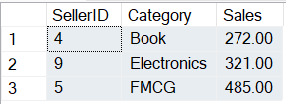
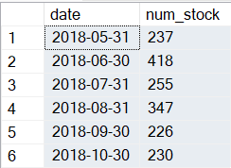
PART 1. SQL
a.
Step 1: Create the Sales table Step 2: Execute query results (Use CTE, Window Function) Step 3: Export the results
b.
Step 1: Create the Sales table Step 2: Execute query results (Use CTE, Window Function, Join Table, Aggregation Function) Step 3: Export the results

Slide 4
PART 1. SQL
QUESTION 2:
Write a SQL query to find the number of product that were available for sales at the end of each month.
Average stock is calculated as: Total stock in a month/ total date in a month. Write a SQL query to find Product ID with the most “average stock” by month.

Slide 5
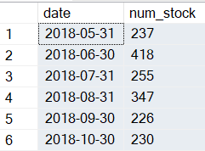
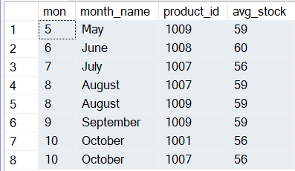
PART 1. SQL
a.
Step 1: Create the Sales table Step 2: Execute query results (Use CTE, Aggregation Function) Step 3: Export the results
b.
Step 1: Create the Sales table Step 2: Execute query results (Use CTE, Window Function, Date Function, Aggregation Function) Step 3: Export the results

Slide 6
PART II. Logical & Problem Solving
QUESTION : A Seller wants to sell cosmetics on Tiki.vn. However, he concerns about the total volume he would make via Tiki.vn. Supposed you have accessed to Tiki’s data warehouse (sales record, items record…), how do you estimate the total sales he is going to have via selling on Tiki.vn? Feel free to make assumptions in the answer.

Slide 7
PART II. Logical & Problem Solving
Historical analytics to estimate total revenue:
Filter the data by the cosmetics category for analysis.
Analyze sales performance:
Revenue and profit
Average Order Value (AOV) per product
Number of orders
Conversion rate = number of viewers / number of buyers
Analyze platform costs, shipping costs, return rate, and inventory status.
Analyze customer experience: reviews, ratings, and delivery time.
Additionally, to estimate sales revenue, we can analyze the customer segments targeted by the seller.
Seasonal analytics to understand how revenue varies at different times and to determine which products should be promoted and sold at specific times to optimize revenue.
For example, after analyzing the data, it is found that during the winter in the north, moisturizing products are sold more than in the summer due to the dry climate => Action: intensify marketing for high-moisture products and prepare additional inventory to meet order demand.

Slide 8
PART III. CASE STUDY
A standard Seller on Tiki usually go through these below stages: - Sign-up -> Seller’s Account Activated by Tiki Team -> Listing Product -> Stocking to make product(s) available for sales -> Having transaction
Based on the data file provided, please tell us what is going on with Tiki’s Marketplace. How was it performed? What are your recommendations to make it better?

Slide 9
PART III. CASE STUDY
Cleaning
Column Name
Data type, Data range Constraint
Handling missing value
Unique Constraints
Membership Constraints for categorical data
Cross- field validation for data columns
Processing
Adding columns for analysis
Aggregation data
Handling oulier data

Slide 10
PART III. CASE STUDY
Main Category | count | mean | std | min | 25% | 50% | 75% | max
BBFF | 1107 | 49.28817 | 37.97033 | 1 | 23 | 38 | 66 | 261
Book | 127 | 36.31496 | 29.29968 | 2 | 14 | 26 | 50 | 148
Digital Service | 116 | 52.57759 | 41.98057 | 4 | 19.75 | 41 | 79 | 185
Electronic | 255 | 49.26275 | 40.98374 | 2 | 19.5 | 37 | 68.5 | 201
LifeStyle | 491 | 50.35031 | 39.46007 | 2 | 21 | 40 | 68 | 259
Notes:
Overview about data by main category

Slide 11
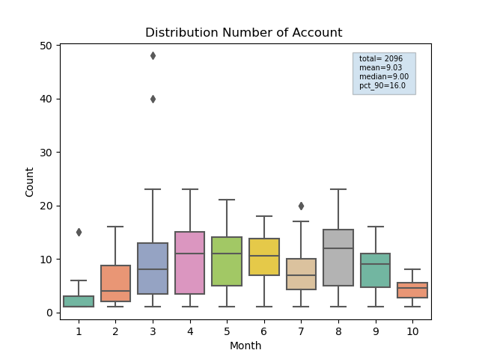
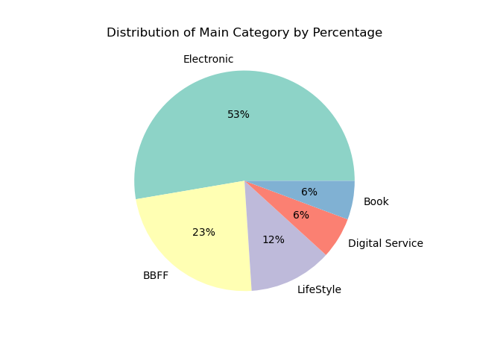
PART III. CASE STUDY
Notes:
Tập dữ liệu bao gồm time-line từ lúc đăng nhập đến khi có giao dịch bán hàng đầu tiên của seller thuộc các ngành hàng: Baby – Beauty – Food and Fashion, Book, Digital Service, Electronic, LifeStyle trong khoảng thời gian từ 2018-01-01 đến 2018-10-01.
Biểu đồ cho thấy số lượng tài khoản đăng ký một xu hướng tăng đột biến trong khoảng từ tháng 3 đến tháng đầu 4 năm 2018 với đỉnh điểm có lúc lên đến xấp xỉ 50 tài khoản/ ngày. Sau đỉnh điểm này, số lượng tài khoản đăng ký biến động nhưng có xu hướng giảm dần về cuối tháng 10 năm 2018.

Slide 12
PART III. CASE STUDY
Focus on analyzing outliers:
Capitalize on opportunities or address encountered issues?
From March and April, the data shows significant dispersion and outlier values due to marketing campaigns or events occurring in early April 2018?
Notes:
Analyze the marketing strategy during this period to identify the success factors that led to significant fluctuations: Is there any difference compared to other months => an increase in the number of registered accounts.
Action: Some of these marketing strategies should be applied to other months to maintain interest and increase the number of registered accounts.
For example: reducing the initial registration fee for sellers, sharing success stories of current sellers to build trust and attract new sellers, etc.

Slide 13
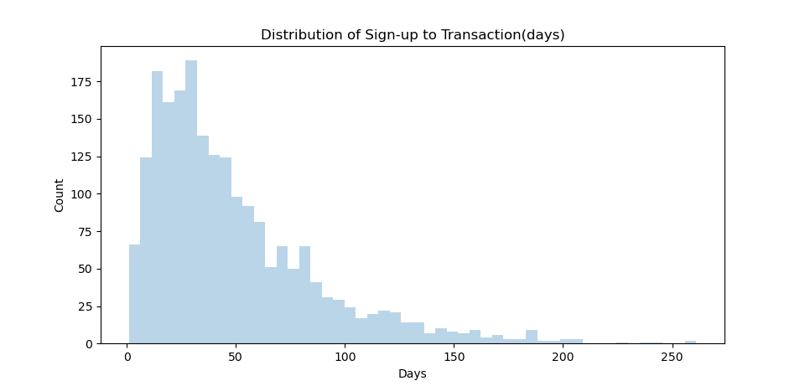
PART III. CASE STUDY
Objective: Reduce the time from sign-up to achieving the first transaction to 30 days!
Notes:
Left-skewed distribution: The chart shows that the majority of sellers complete their transactions within 50 days after registration. There are a few sellers who make their first transaction immediately after registration, and this number decreases over time.
Peak: There is a clear peak around 0-50 days, with the highest number of sellers completing transactions within this period.
Gradual decrease: After about 50 days, the number of users completing transactions gradually declines, and very few make transactions after 150 day

Slide 14
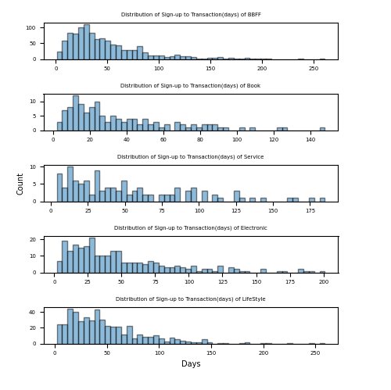
PART III. CASE STUDY
Support sellers in the early stages after registration, especially during the first 50 days.
Notes:
BBFF (Baby, Beauty, Food, Fashion) Most sellers in this category complete their first transaction within 50 days after sign-up. There is a gradual decrease in transactions after 50 days, with very few occurring after 100 days.
Book The number of first transactions is concentrated in the 0-30 day period after sign-up. After 50 days, there is a significant drop in transactions, and very few occur after 100 days.
Digital Service Most first transactions occur within 0-50 days, but a notable number also occur between 50-100 days. This distribution indicates that the time to first transaction is longer compared to other categories.
Electronic The majority of first transactions occur within 0-50 days. After 100 days, the number of first transactions is almost negligible.
LifeStyle The number of first transactions is primarily concentrated within the first 50 days. Similar to other categories, the number gradually decreases, with fewer transactions occurring after 100 days.

Slide 15
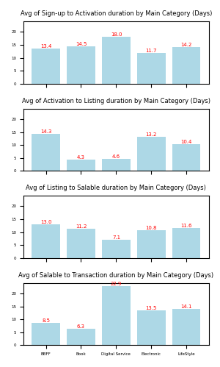
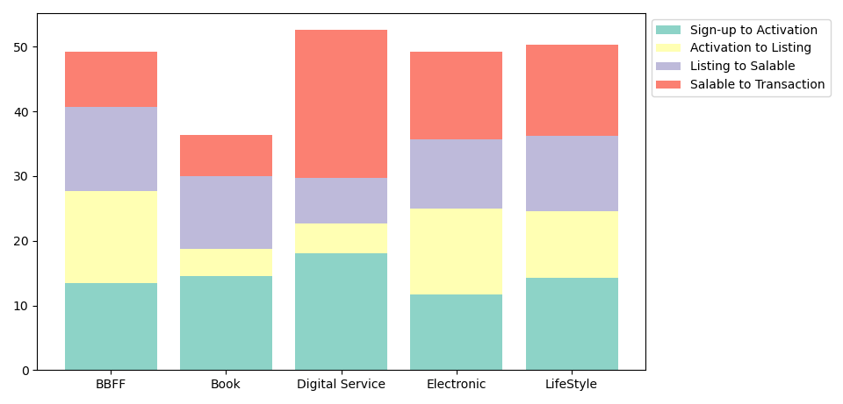
PART III. CASE STUDY
Notes:
Data shows differences in the average time from registration to the first transaction across product categories, with the "Digital Service" category having the longest average time and "Book" having the shortest. The remaining three categories—BBFF, Electronic, LifeStyle—have approximately similar average times.
Insight:
Books are physical products with a less complex sales process compared to other products. Listing books on the platform typically requires less detailed description and quality checks compared to items like electronics or digital services. Books also have a stable customer base, including frequent book buyers. This can lead to faster sales times, as book buyers are often familiar with online shopping and know what they want to purchase. However, the time between listing and the book actually being available for sale is relatively long (avg = 11.2) because some publishers or sellers may choose to list books before they are available to build anticipation and prepare for sales.
Digital Services have the longest average time to achieve the first order (approximately 53 days). This is due to two main factors: the account approval time and the time from when the product is stock-ready to when the first order is received being significantly longer compared to other categories.
Thorough Verification: Digital services undergo a rigorous verification process to ensure quality and compliance with security standards, which can delay the official launch and readiness for customers.
Building Trust: Digital services require time to build reputation and trust with customers, especially those related to personal data or sensitive information. Customers may need time to research and trust the quality and reliability of the service before making a transaction.
For the remaining categories—BBFF, Electronic, LifeStyle—the average time from registration to the first transaction is relatively high, approximately 49 days.
BBFF: This category has a high average listing time due to the diverse range of consumer products, which vary in size, color, images, etc.
Electronic: High-value items, or LifeStyle (Non-Essential Goods) often related to trends and lifestyle, may require time to be recognized and integrated into the market, resulting in a longer time from product availability to the first order. Conversely, BBFF, being essential consumer goods, have stable purchasing power, shorter consumption times, and are less affected by trend changes, leading to shorter purchase times.

Slide 16
PART III. CASE STUDY
Clear Instructions
Accelerate Verification Process
Immediate Notifications
Quick Product Listing Tools
Testing and Guidance
Forecasting and Inventory Management
Logistics Support
Promotional and Advertising Campaigns
RECOMENDATIONS:
Notes:
Clear Instructions: Provide step-by-step instructions for the registration process to make it easier for sellers to complete.
Accelerate Verification Process: Use automated verification technology and minimize manual processing time.
Immediate Notifications: Notify sellers as soon as their accounts are activated, along with the next steps.
Quick Product Listing Tools: Offer auto-fill templates and OCR technology support to input product data from images or documents.
Testing and Guidance: Provide guidelines on writing engaging product descriptions and optimizing keywords to improve product visibility.
Forecasting and Inventory Management: Offer tools to help sellers forecast demand and manage inventory effectively.
Logistics Support: Suggest linked logistics services to help sellers quickly replenish stock and be ready for transactions.
Promotional and Advertising Campaigns: Provide promotional or advertising packages to help new sellers attract customers.

